Slide 1
Bell Work Quiz
Prepare for the bell work quiz covering two-step equations.
You will need notebook paper and a pencil.

Slide 2
Bell Work Quiz
Evaluate each of the two-step equations.
3x + 1 = 7
2 − $\frac{g}{5}$ = 6
$\frac{y}{4}$ + 1 = 9
1 – 8x = 9

Slide 3
4-3A Similar Figures
Same shape, different size!

Slide 4
Similar Figures
Figures that have the same shape but not necessarily the same size are similar figures. Triangle RST is similar to triangle XYZ.

Slide 5
Corresponding Parts

Slide 6
Two figures are similar if:
The corresponding sides are proportional (all sides are multiplying or dividing by the same factor)
The corresponding angles are congruent (all angles are the same if we measured)

Slide 7
Symbolically speaking:
Displaying
Congruent Angles
Similar to
Congruent to
(same!)

Slide 8
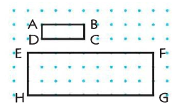
Corresponding Sides
These two rectangles are similar
Identify the corresponding sides
AB = BC =
CD = DA =
3
1
What do you notice about these two proportions?
AB EF
BC FG
3
9

Slide 9
Identifying Similar Figures
To identify: Compare a ratio of original sides to the corresponding sides. If they are equal, the shapes are similar.
*You may also make proportions of corresponding sides and compare!
Note: Remember to choose the same sides in the same order.

Slide 10
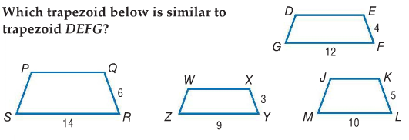
You Try

Slide 11
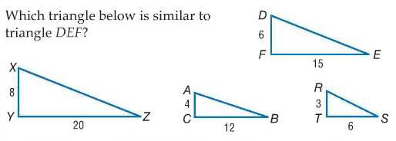
Check Your Progress

Slide 12
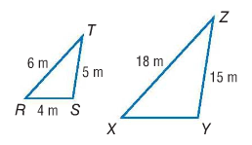
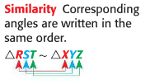
Finding Missing Measures
Set up the proportions as if identifying similar figures using x as missing side.
Calculate cross products.
Solve for x!

Slide 13
Finding Missing Measures

Slide 14
Indirect Measurement

Slide 15
Indirect Measurement

Slide 16
Practice

Slide 17
Practice

Slide 18
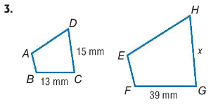
Exit Pass

