Slide 1
Bell Work
Solve the following two-step equations.
$\frac{x}{3}−5=2$
$2−4w=10$

Slide 2
Proportional Relationships

Slide 6
You Try

Slide 8
Think-Pair-Share

Slide 9
Bell Work
Evaluate the following two-step equations.
$4x −1= \frac{1}{2}$
$5−\frac{s}{3}=7$

Slide 10
Scales (701 and 706)
Complete a self assessment on scales 701 and 706
Remember to make sure your rating is accurate. (You can only rate your self a specific level if you can do every thing with in that level and any previous level)

Slide 11
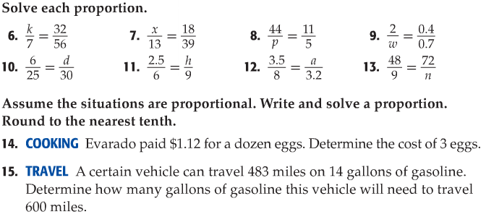
Rally Coach **Complete on a separate piece of notebook paper

