Slide 1
Bell Work
Evaluate the following two-step equation.
$3−7y=30$

Slide 2
Similarity and Proportional Reasoning
Applying Similarity to Area and Perimeter

Slide 3
Reminders
Perimeter- Distance around a shape. (Add the sides!)
Area- space inside an object
For a square, the area = length x width
Area always has squared units!

Slide 4
Explore!

Slide 5
Breakdown
For new perimeter: Take the perimeter of the original and multiply by the scale factor
For new area: multiply the old area by the scale factor squared

Slide 6
Example:
Identify Scale Factor (2nd/1st)
Find perimeter
Multiply old perimeter by scale factor
Scale Factor: 18/24
Perimeter of first:
64
X
= 48m

Slide 7
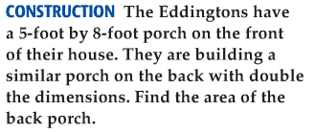
Area Example
Scale Factor: 2
Identify Scale Factor
Find original area
Multiply original by scale factor squared!
Area= l x w:
8x5=40ft²
New area: 40x 2² = 40 x 4 =160ft²

Slide 8
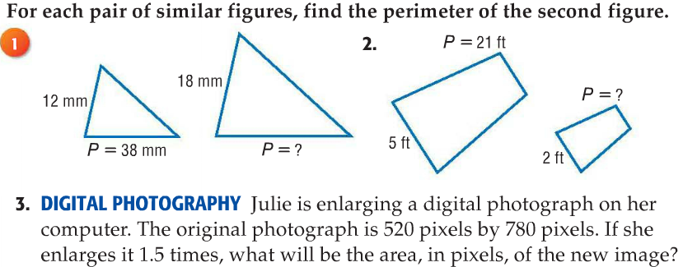
Check Your Understanding

