Slide 1
Bell Work
What do you do to the exponents when taking the quotient of powers?
When taking the quotient of powers with like bases I subtract the exponents.
How is this different from the product of powers?
The product of powers is different from the quotient of powers because I add the exponents instead of subtracting them.
Evaluate the following expressions using positive exponents.
$$\frac{r^{4}}{r^{9}}$$
**Have your homework out for me to check! (workbook pages 211 and 213)

Slide 2
Will these products be positive or negative? How do you know?
$$−1 ×−1 × … ×−1={−1}^{8}$$
8 times
Positive
(There is an even number of negative factors)
$$−1 ×−1 ×… ×−1= {−1}^{9}$$
9 times
Negative
(There is an odd number of negative factors)

Slide 3
Is it necessary to do all of the calculations to determine the sign of the product? Why or why not?
No, the sign can be determined by the number of negative factors.
$$−5 ×−5 × … ×−5={−5}^{95}$$
95 times
Negative (odd number of negatives)
$$−1.8 ×−1.8 ×… ×−1.8= {−1.8}^{122}$$
122 times
Positive (even number of negatives)

Slide 4
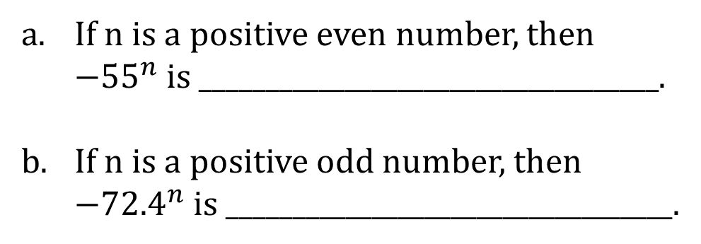
Fill in the blacks about whether the number is positive or negative.
If n is a positive even number, then ${−55}^{n}$ is ___________________________________.
If n is a positive odd number, then ${−72.4}^{n}$ is __________________________________.
POSITIVE
NEGATIVE

Slide 5
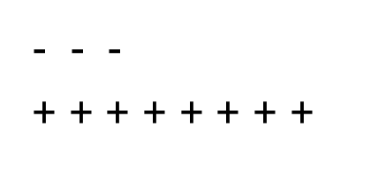

Product and Quotient of Powers
Let x be a positive integer. If ${−3}^{9}×{−3}^{x}= {−3}^{14}$, what is x?
$(\frac{5}{x^{3}}) 3x^{8}=$
$$9+x=14$$
$$x=5$$
$$\frac{5}{x^{3}}=5x^{−3}$$
$$5x^{−3}×3x^{8}$$
$$15x^{−3+8}$$
$$15x^{5}$$
- - -
+ + + + + + + +

Slide 6
Rally Coach
Re-write the following numbers using Scientific Notation
81,000
1,396,000
80,000,000
0.00015
0.0000317
**When your entire team is done check your answers!

Slide 7
Rally Coach
Re-write the following numbers in Standard Form.
$1.9×{10}^{5}$
$2.43×{10}^{−7}$
$5.28×{10}^{9}$
$3.41×{10}^{−6}$
$6×{10}^{8}$
**When your entire team is done check your answers!

Slide 8
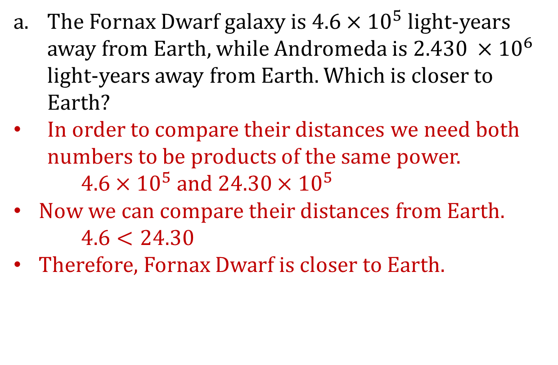
Comparing Numbers Written in Scientific Notation
The Fornax Dwarf galaxy is $4.6×{10}^{5}$ light-years away from Earth, while Andromeda is $2.430 ×{10}^{6}$ light-years away from Earth. Which is closer to Earth?
In order to compare their distances we need both numbers to be products of the same power.
$4.6×{10}^{5}$ and $24.30×{10}^{5}$
Now we can compare their distances from Earth.
$4.6<24.30$
Therefore, Fornax Dwarf is closer to Earth.

Slide 9
Comparing Numbers Written in Scientific Notation
The average lifetime of the tau lepton is $2.906×{10}^{−13}$seconds, and the average lifetime of the neutral pion is $8.4×{10}^{−17}$seconds. Explain which subatomic particle has a longer average lifetime.
$29,060×{10}^{−17}and 8.4×{10}^{−17}$
$29,060>8.4$
Therefore, Tau Lepton has a longer average lifetime.
Compare $9.3×{10}^{28}$ and $9.2879{10}^{28}$.
They are both products of the same power so we only need to compare 9.3 and 9.287910
$9.3>9.287910$
Therefore, $9.3×{10}^{28}is larger than 9.287910×{10}^{28}$

Slide 10
Comparing Numbers Written in Scientific Notation
Chris said that $5.3×{10}^{41}<5.301×{10}^{41}$because 5.3 has fewer digits than 5.301. Show that even though his answer is correct, his reasoning is flawed. Show him an example to illustrate that his reasoning would result in an incorrect answer. Explain.

Slide 11
Operations with Numbers in Scientific Notation
The speed of light is 300,000,000 meters per second. The sun is approximately $1.5×{10}^{11}$ meters form Earth. How many seconds does it take for sunlight to reach Earth?
First we need to put 300,000,000 into scientific notation: $3×{10}^{8}$
We can then set up a ratio $\frac{distance}{speed}$ to find out how long it will take.
$\frac{1.5×{10}^{11}}{3×{10}^{8 }}=\frac{1.5}{3}×\frac{{10}^{11}}{{10}^{8}}$
$0.5×{10}^{3}=500$
It takes 500 seconds for sunlight to reach the Earth.

Slide 12
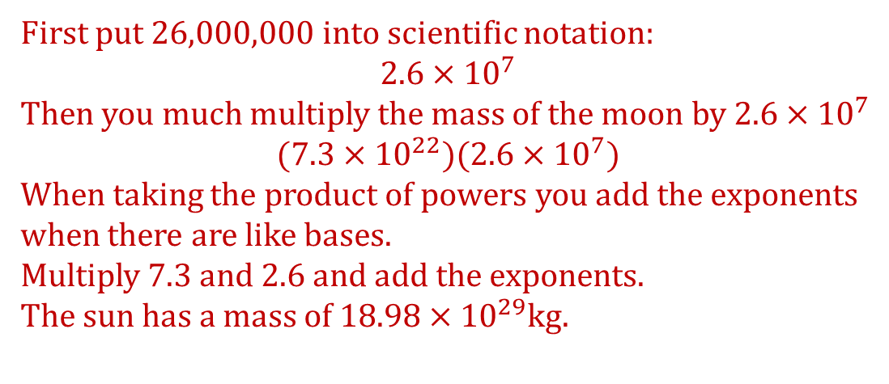
Operations with Numbers in Scientific Notation
The mass of the moon is about $7.3×{10}^{22}$ kg. It would take approximately 26,000,000 moons to equal the mass of the sun. Determine the mass of the sun.
First put 26,000,000 into scientific notation:
$$2.6×{10}^{7}$$
Then you much multiply the mass of the moon by $2.6×{10}^{7}$
$$(7.3×{10}^{22})(2.6×{10}^{7})$$
When taking the product of powers you add the exponents when there are like bases.
Multiply 7.3 and 2.6 and add the exponents.
The sun has a mass of $18.98×{10}^{29}$kg.

Slide 13
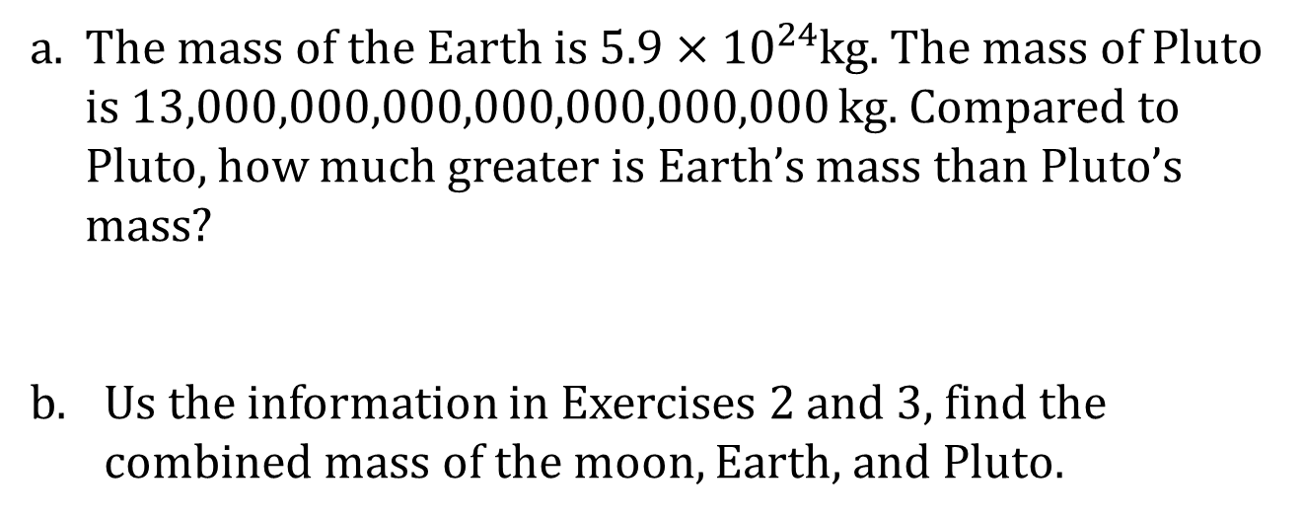
Operations with Numbers in Scientific Notation
The mass of the Earth is $5.9×{10}^{24}$kg. The mass of Pluto is 13,000,000,000,000,000,000,000 kg. Compared to Pluto, how much greater is Earth’s mass than Pluto’s mass?
Us the information in Exercises 2 and 3, find the combined mass of the moon, Earth, and Pluto.

Slide 14
Efficacy of Scientific Notation
The mass of a proton is 0.000000000000000000000000001672622 kg.
In scientific notation it is: _____________________________________________________
The mass of an electron is 0.000000000000000000000000000000910938291 kg.
In scientific notation it is: _____________________________________________________
$$1.672622×{10}^{−27}$$
$$9.10938291×{10}^{−31}$$

Slide 15
Efficacy of Scientific Notation
Write the ratio that compares the mass of a proton to the mass of an electron.
Compute how many times heavier a proton is than an electron (that is, find the value of the ratio). Round your final answer to the nearest one.

Slide 16
Efficacy of Scientific Notation
The geographic area of California is 163,696 sq. mi., and the geographic area of the U.S. is 3,794,101 sq. mi. Let’s round off these figures to $1.637×{10}^{5}$. In terms of area, roughly estimate how many Californias would make up one U.S. Then compute the answer to the nearest ones.

Slide 17
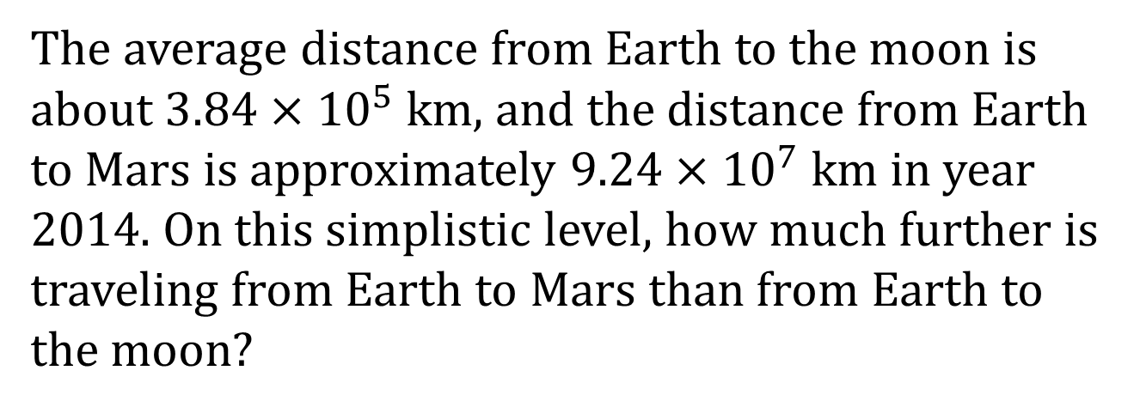
Efficacy of Scientific Notation
The average distance from Earth to the moon is about $3.84×{10}^{5}$ km, and the distance from Earth to Mars is approximately $9.24×{10}^{7}$ km in year 2014. On this simplistic level, how much further is traveling from Earth to Mars than from Earth to the moon?

