Slide 1
Bell Work
How do you think you did on the Math FSA? Did you feel prepared?
What is one math related goal you want to accomplish between now and the end of the school year?

Slide 2
13-4 A Multiply and Divide Monomials

Slide 3
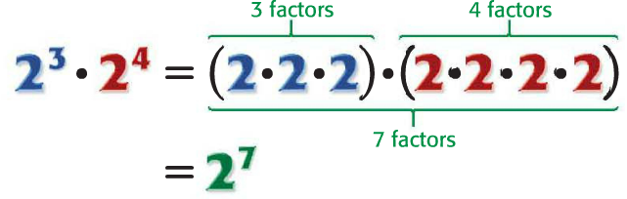
Product of Powers
Remember: exponents are used to show repeated multiplication
What would you do to simplify 4⁵ x 4⁶ ?

Slide 4
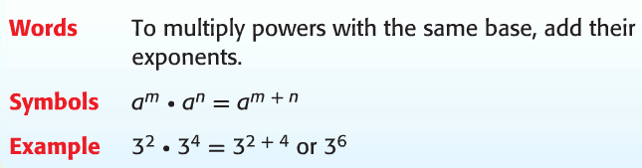
Product of Powers

Slide 5
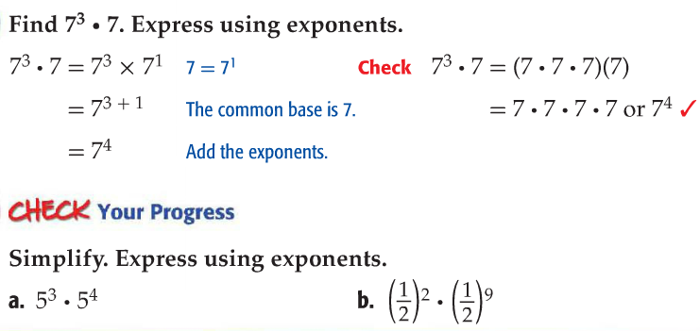
Multiply Powers

Slide 6
Vocabulary
A monomial is a number, variable, or product of a number and one or more variables.

Slide 7
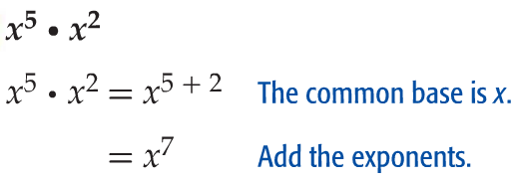
Multiplying Monomials
You can multiply monomials using the product of powers. Find each product.

Slide 8
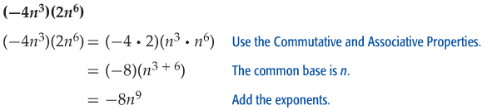
Multiplying Monomials
You can multiply monomials using the product of powers. Find each product.

Slide 9

Check Your Progress

Slide 10
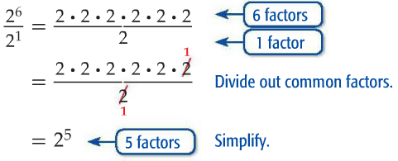
Quotient of Powers
How do you get an exponent of 5 from the initial exponents of 6 and 1?

Slide 11
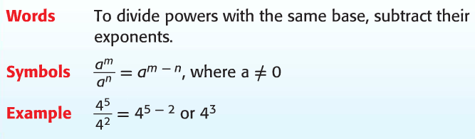
Quotient of Powers

Slide 12
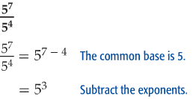
Dividing Powers
You can divide monomials by subtracting the exponent. Find each quotient.

Slide 13
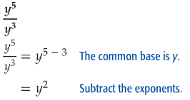
Dividing Powers
You can divide monomials by subtracting the exponent. Find each quotient.

Slide 14
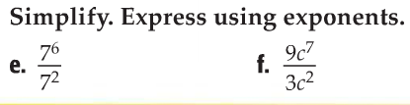
Check Your Progress

Slide 15
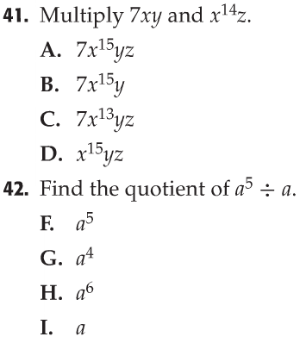
You Try

Slide 16
13-4B Negative Exponents

Slide 17
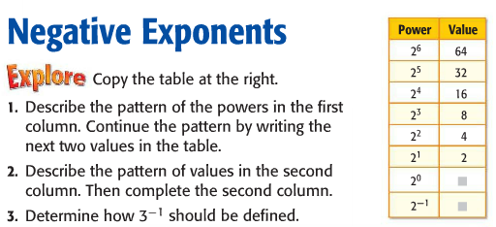
Analyze the Pattern

Slide 18
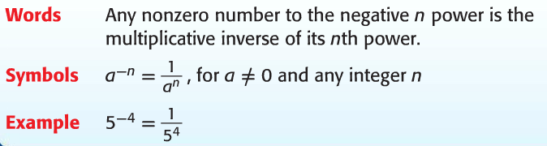
Negative Exponents
What does the phrase “multiplicative inverse” mean?
What do you think a number in the denominator with a negative exponent would look like?

Slide 19
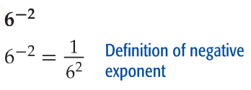
Use Positive Exponents
Write each expression using a positive exponent.

Slide 20
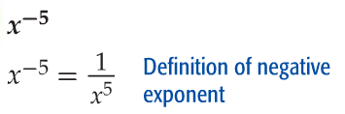
Use Positive Exponents
Write each expression using a positive exponent.

Slide 21


Check Your Progress

Slide 22
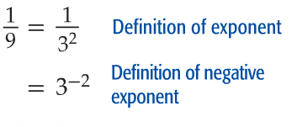
Use Negative Exponents
Write each expression using a negative exponent.

Slide 23
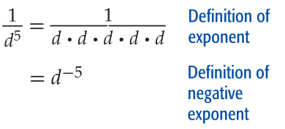
Use Negative Exponents
Write each expression using a negative exponent.

Slide 24


Check Your Progress

Slide 25

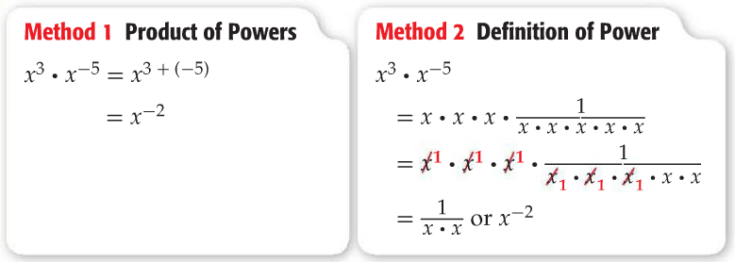
Perform Operations with Exponents

Slide 26

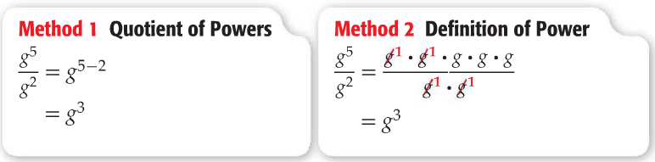
Perform Operations with Exponents

Slide 27

Check Your Progress

Slide 28
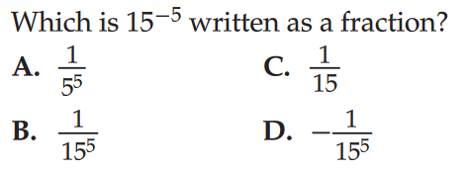
Practice

Slide 29
13-4C Scientific Notation

Slide 30
Express Numbers in Scientific Notation
Scientific Notation
Examples:
6,320,000,000
=
9 jumps left
0.000027
=
5 jumps right

Slide 31

Large Numbers – Positive Exponents
59,000,000
=
7 jumps left
140,000,000,000
=
11 jumps left
Small Numbers – Negative Exponents
0.000426
=
4 jumps right
0.000009
=
6 jumps right

Slide 32

Write using scientific notation.
1) 81,000
4) 0.00015
4 jumps left
4 jumps right
2) 1,396,000
5) 0.0000317
6 jumps left
5 jumps right
3) 80,000,000,000
10 jumps left

Slide 33

Express Large Numbers in Standard Form
What does 10⁵ mean?
If you multiplied 2.16 by that number what would you get?
Remember:
POSITIVE EXPONENTS = large number (# > 1)

Slide 34

Express Small Numbers in Standard Form
What does 10⁻³ mean?
If you multiplied 5.8 by that number what would you get?
Remember:
NEGATIVE EXPONENTS = small number (# < 1)

Slide 35
Write each number in standard form.
1)
4)
1.9
0
0
0
0
0
0
0
0
0
0
3.41
190,000
0.00000341
2)
5)
0
0
0
0
0
0
0
2.43
6
0
0
0
0
0
0
0
0
0.000000243
600,000,000
3)
5.28
0
0
0
0
0
0
0
5,280,000,000

Slide 36

Order the following from greatest to least
Comparing Numbers in Scientific Notation
Look at the exponents!
The number with the greater exponent is greater.
If the exponents are the same, compare the factors.

Slide 37
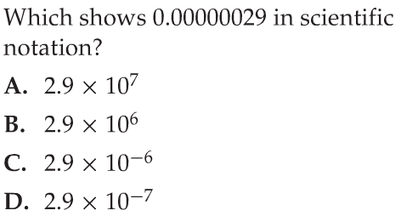
Practice

Slide 38
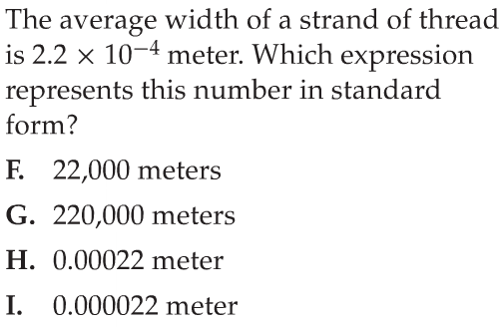
Practice

Slide 39
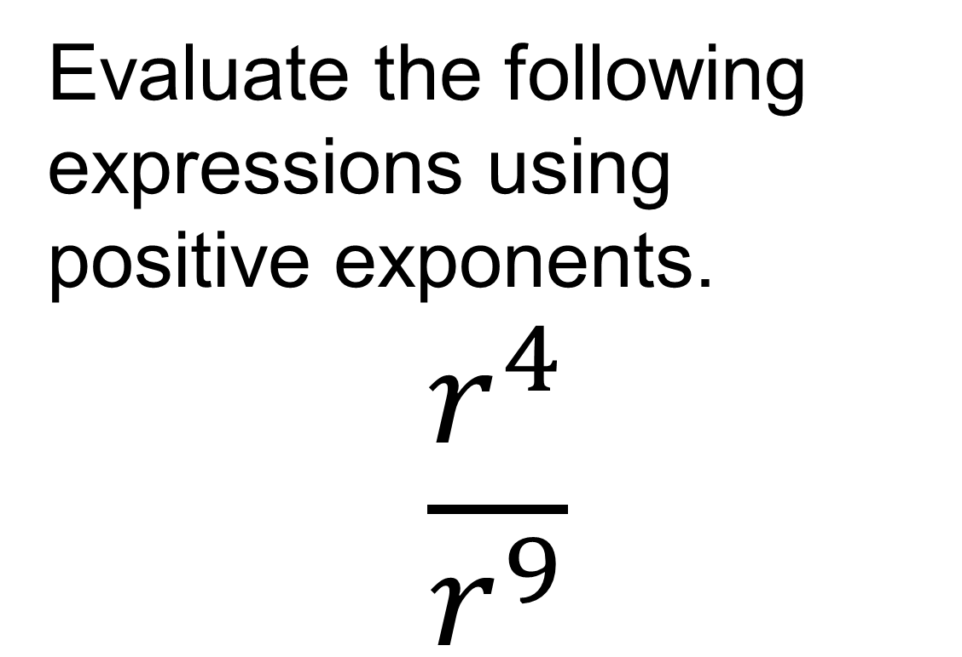
Exit Slip:
Evaluate the following expressions using positive exponents.
$$\frac{r^{4}}{r^{9}}$$

