Slide 1
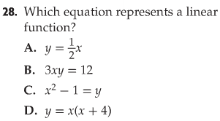
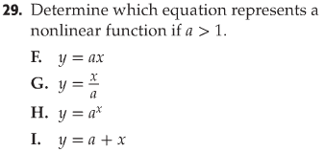
Bell Work

Slide 2
13-4 A Multiply and Divide Monomials

Slide 3
Product of Powers
Remember: exponents are used to show repeated multiplication
What would you do to simplify 4⁵ x 4⁶ ?

Slide 4
Product of Powers

Slide 5
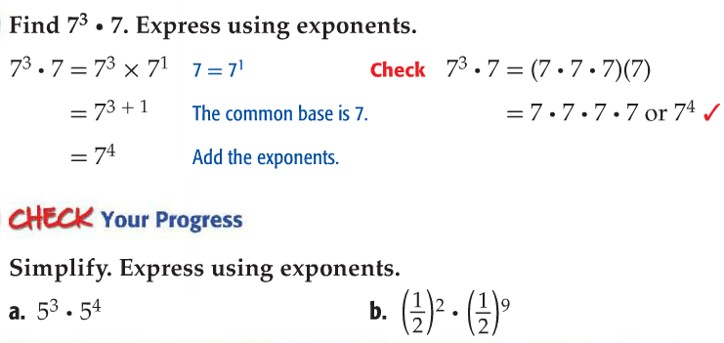
Multiply Powers

Slide 6
Vocabulary
A monomial is a number, variable, or product of a number and one or more variables.

Slide 7
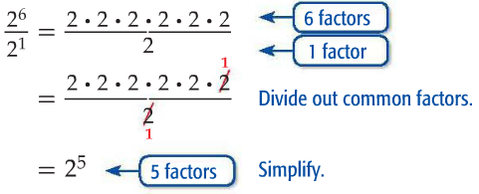
Quotient of Powers
How do you get an exponent of 5 from the initial exponents of 6 and 1?

Slide 8
Quotient of Powers

Slide 9
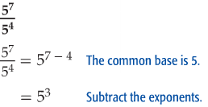
Dividing Powers
You can divide monomials by subtracting the exponent. Find each quotient.

Slide 10
Check Your Progress

Slide 11
13-4B Negative Exponents

Slide 12
Analyze the Pattern

Slide 13
Negative Exponents
What does the phrase “multiplicative inverse” mean?
What do you think a number in the denominator with a negative exponent would look like?

Slide 14
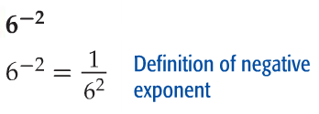
Use Positive Exponents
Write each expression using a positive exponent.

Slide 15
Check Your Progress

Slide 16
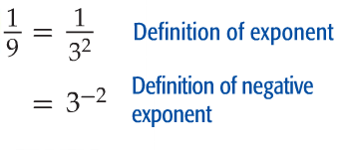
Use Negative Exponents
Write each expression using a negative exponent.

Slide 17
Check Your Progress

Slide 18
Perform Operations with Exponents

Slide 19
Perform Operations with Exponents

Slide 20
Check Your Progress

Slide 21
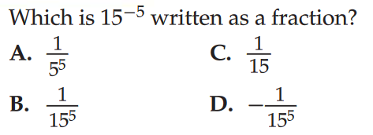
NGSSS

