Slide 1
Bell Work

Slide 2
11-3F Distance on a Coordinate Plane
Students will be able to find the distance between two points on the coordinate plane.

Slide 3
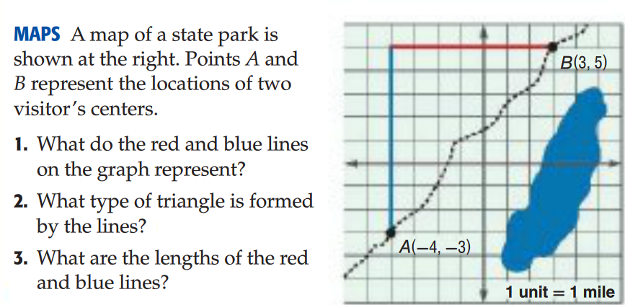
Explore

Slide 4
How to find a distance on a coordinate plane
Plot the given points on graph paper
Draw a line segment between the two points.
Form a right triangle then, find the lengths of the legs of the triangle.
Apply the Pythagorean Theorem to find the length of the hypotenuse!

Slide 5
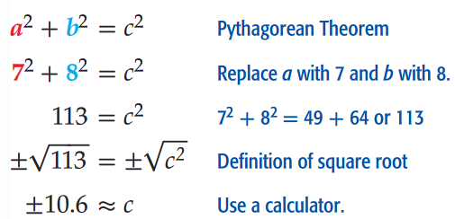
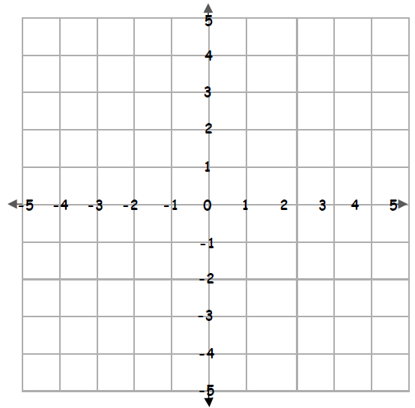
Example- Find the distance
Can a length be negative?
No! Use only the positive result ☺

Slide 6
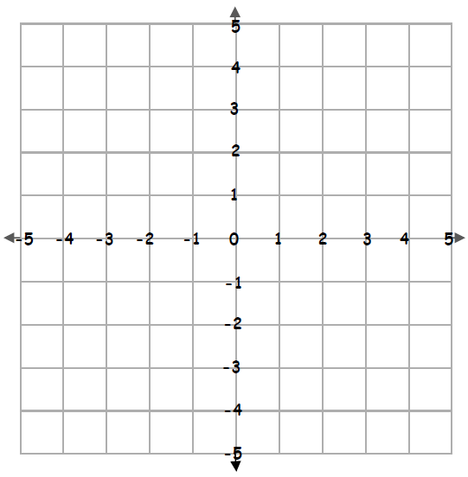
Check Your Progress
Find the distance between the points (-3,2) and (4, -1) Round to the nearest tenth if necessary.
Notes:
7.6 units

Slide 7
You Try- Draw a picture!
Notes:
300 miles

Slide 8
Check your understanding pg 662 Rally Coach

Slide 9
Homework
Workbook pages 179 and 181 ODD
Early finishers can work on missing assignments or read a book!
*Make sure you turned your classwork into the orange bin!

