Slide 1
Bell Work
Find the squares of the following numbers
1. 3² ⁼
2. 6² ⁼
3. What is the square of 8?

Slide 2
Bell Work
Find the squares of the following numbers
1. 3² = 9
2. 6² = 36
3. What is square of 8? 64

Slide 3
11-3AB Solving and Estimating Square Roots
Students will be able to find the values of square roots. Students will be able to estimate square roots.

Slide 4
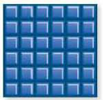
Explore!
A square with an area of 36 square units is shown.

Slide 5
Explore!
In your group, try to construct (draw) squares with areas of 9, 12, 18, 16, and 20.
List the areas that can create squares.

Slide 6
Explore!
What is the relationship between the lengths of the squares and the areas?
Using your square tiles, create a square the has an area of 49 square units. What are the lengths of the sides of the square?

Slide 7
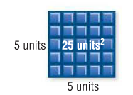
Vocabulary

Slide 8
Vocabulary
Square- the product of a number and itself
Perfect Square – a number that is a square of a whole number
Square Root- factors multiplied to form perfect squares
Radical Sign (√)- a symbol used to indicate a square root

Slide 9
Vocabulary

Slide 10
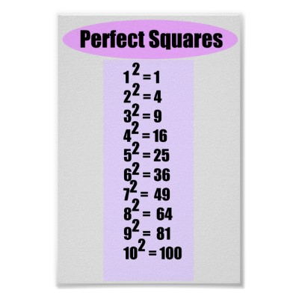
List of Common Perfect Squares
11² = 121
12² = 144

Slide 11
How to find a square root
Find what two identical factors multiply to give you the number under the radical. This factor is the answer.
Ex:

Slide 12
Example

Slide 13
Example
15

Slide 14
You Try
Find the square roots below.
1. $\sqrt{144}$ | 2. $\sqrt{16}$ | 3. $\sqrt{49}$

Slide 15
You Try
Find the square roots below.
12 4 7

Slide 16
Estimating Square Roots

Slide 17
How to estimate square roots
Make a list of perfect squares below and above your number.
Find which two perfect squares it is between.
Decide which perfect square it is closest to.
The square root of the chosen perfect square is the estimate.

Slide 18
How to estimate square roots
Make a list of perfect squares
Find which two perfect squares it is between.
Decide which perfect square it is closest to.
The square root of the chosen perfect square is the estimate.
Example:
78

Slide 20
You Try
Estimate the following square roots:
1. 2. 3.

Slide 21
You Try
Estimate the following square roots:
1. 2. 3.
89 is between 81 and 100, so the square root of 89 is approximately 8.
116 is between 100 and 121, so the square root of 116 is approximately 11.
35 is between 25 and 36, so the square root of 35 is approximately 6.

Slide 22
How to find the square root with a calculator
Type the number beneath the radical
Click the radical sign
Hit enter!
You may use calculators to check your answer.
* Some calculators might have a specific button for this function where you must type the radical sign before typing the number.

Slide 23
11-3C The Real Number System
Students will be able to identify and classify numbers in the real number system, and compare mathematical expressions involving real numbers.

Slide 24
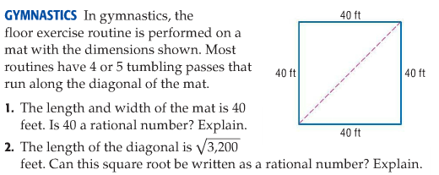
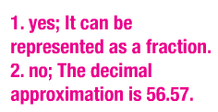
The Real Number System

Slide 25
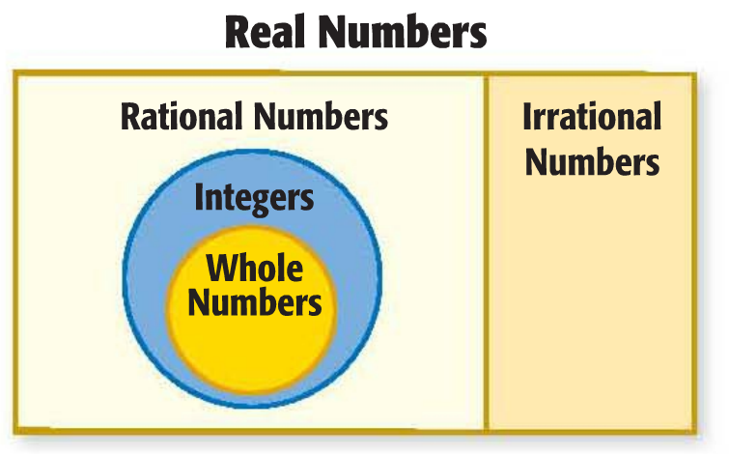

Slide 26
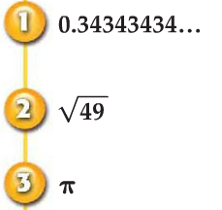
Classify Numbers
Name all sets of numbers to which each real number belongs.

Slide 27
Check Your Progress
Name all sets of numbers to which each real number belongs.

Slide 28
Real numbers follow the properties that hold true for whole numbers, integers, and rational numbers.

Slide 29
Graph Real Numbers

Slide 30
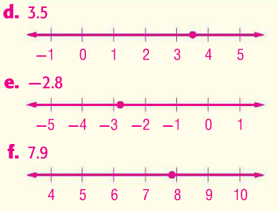
Check Your Progress
Find each square root to the nearest tenth. Then graph the square root on a number line.

Slide 31
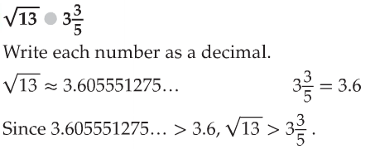
Compare Real Numbers

Slide 32
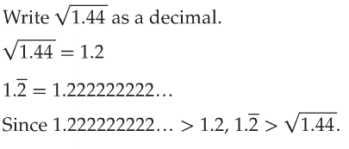
Compare Real Numbers

Slide 33
Check Your Progress

Slide 34
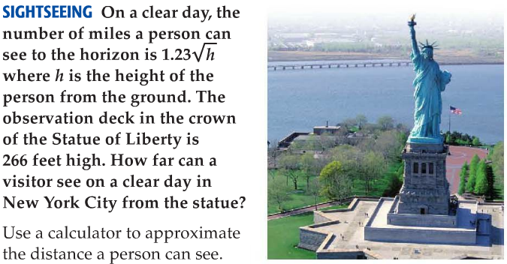
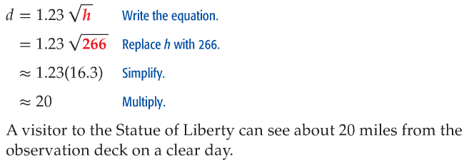
Real-World Example

Slide 35
Check Your Progress

Slide 36
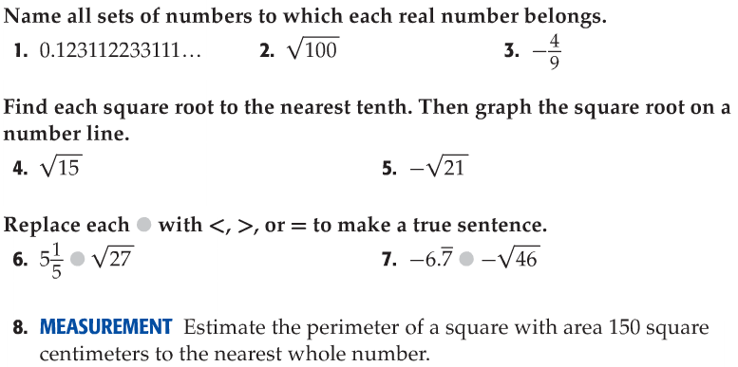
Check Your Understanding Textbook page 652

Slide 37
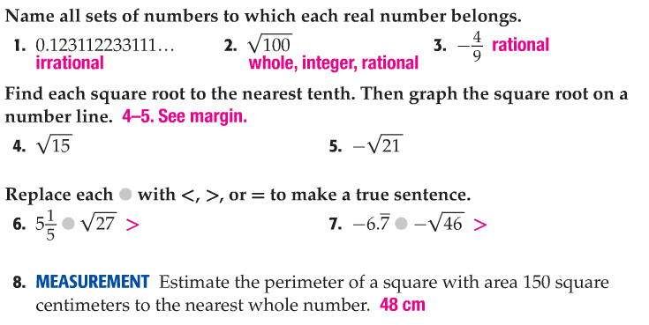
Check Your Understanding Textbook page 652

Slide 38
Start your homework!
Workbook pages
173 # 2-4, 9-11, and 16-17
175 # 1-4, and 23-29
177 ODD

