Slide 1
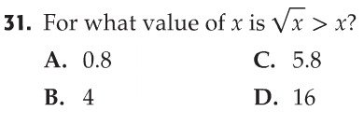
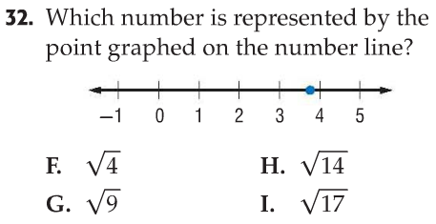
Bell Work

Slide 2
11-3 D/E The Pythagorean Theorem
Students will be able to understand and apply the Pythagorean Theorem.

Slide 3
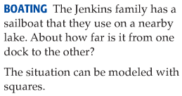
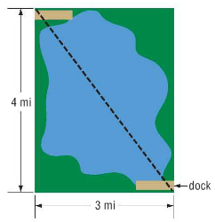
Explore the Pythagorean Theorem.

Slide 4
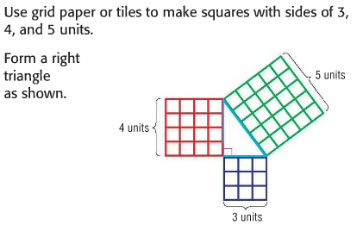
Explore the Pythagorean Theorem.

Slide 5
Analyze the Results

Slide 7
In a right triangle, sides have special names…

Slide 8
The Pythagorean Theorem
Describes the relationship between the length of the hypotenuse and the lengths of the legs.

Slide 9
Remember
The Pythagorean Theorem ONLY works on RIGHT TRIANGLES!!!

Slide 10
Steps to Using the Pythagorean Theorem
Label your sides (a, b, and c) on the triangle.
Write out the Pythagorean Theorem.
Plug in the side lengths for a, b, and c.
Square the sides.
Solve/Simplify.

Slide 11
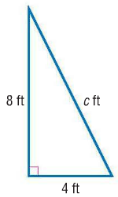
Find the Length of the Hypotenuse
*Check: Does your answer make sense? Remember the hypotenuse is ALWAYS the longest side.

Slide 12
Find the Length of the Hypotenuse

Slide 13
Check Your Progress

Slide 14
Pythagorean Theorem Rap!
http://www.youtube.com/watch?v=DRRVu-RHQWE

Slide 15
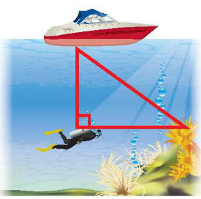
Real-World Example
A scuba diver dove 14 feet below the surface. Then he swam 16 feet horizontally. How far is the diver from his boat?

Slide 16
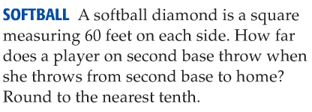
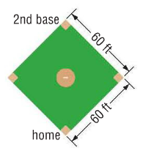
Check Your Progress

Slide 17
Finding the Length of a Leg

Slide 18
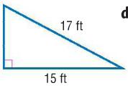
Finding the Length of a Leg

Slide 19
Check Your Progress

Slide 20
Common Pythagorean Triples
There are special integer relationships based on the Pythagorean Theorem, known as Pythagorean Triples.
All Pythagorean Triples can be verified using the Pythagorean Theorem. Some common ones are:
3:4:5
5:12:13
8:15:17
7:24:25
All multiples of these are also Pythagorean Triples. For example, 9:12:15 is fond by multiplying all sides of a 3:4L5 triangle by 3.

Slide 21
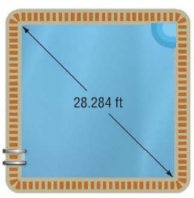
Check Your Progress

Slide 22
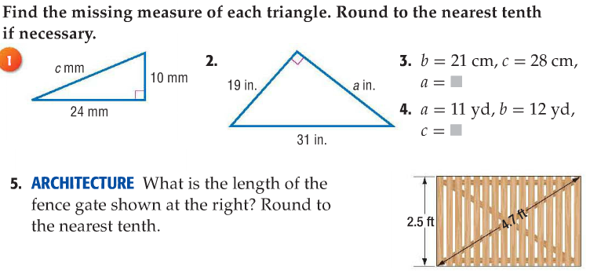
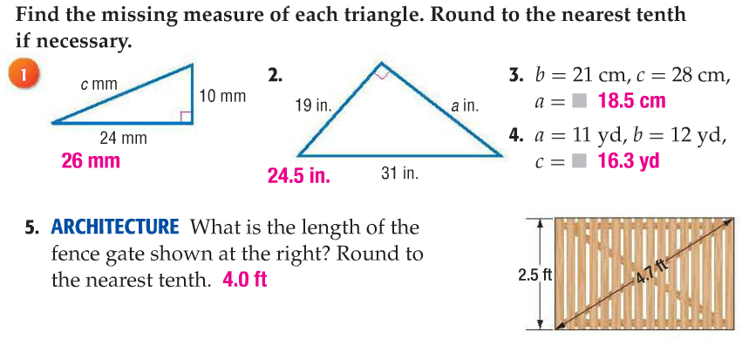
Rally Coach- Check Your Understanding pg 658
* Complete on a sheet of paper to be turned into the bin at the end of class!

Slide 23
11-3F Distance on a Coordinate Plane
Students will be able to find the distance between two points on the coordinate plane.

Slide 24
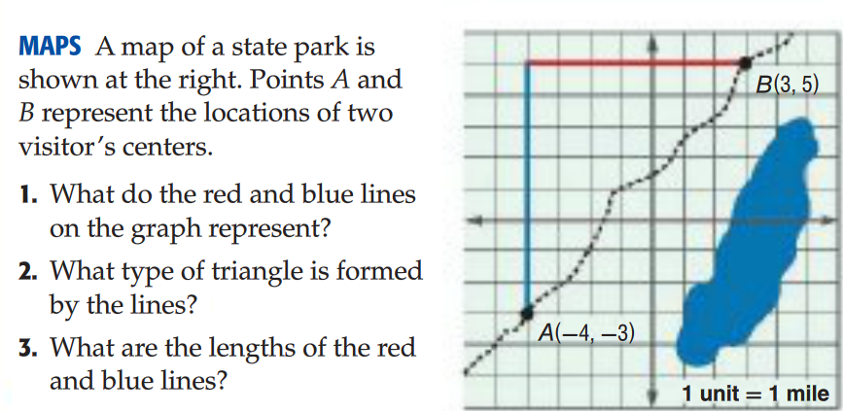
Explore

Slide 25
How to find a distance on a coordinate plane
Plot the given points on graph paper
Draw a line segment between the two points.
Form a right triangle then, find the lengths of the legs of the triangle.
Apply the Pythagorean Theorem to find the length of the hypotenuse!

Slide 26
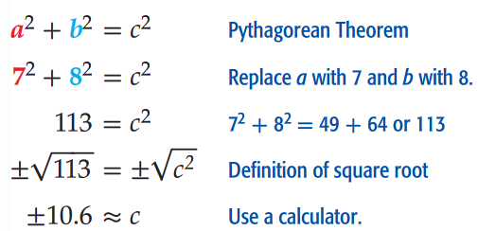
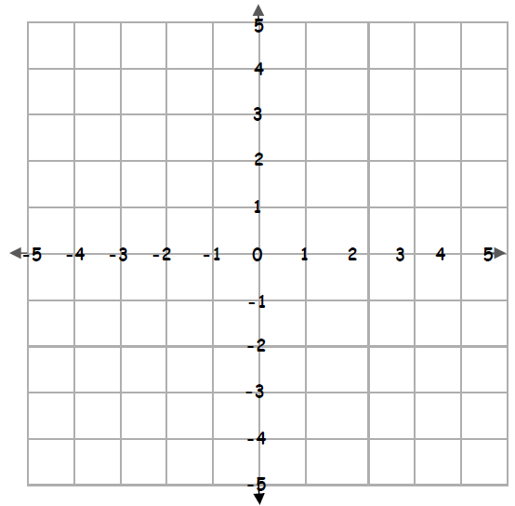
Example- Find the distance
Can a length be negative?
No! Use only the positive result ☺

Slide 27
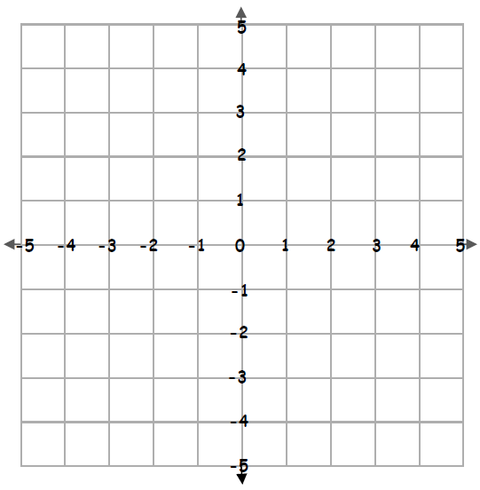
Check Your Progress
Find the distance between the points (-3,2) and (4, -1) Round to the nearest tenth if necessary.
Notes:
7.6 units

Slide 28
You Try- Draw a picture!
Notes:
300 miles

Slide 29
Check your understanding pg 662 * Complete on same sheet of paper to be turned into the bin at the end of class!

Slide 30
Homework
Workbook pages 179 and 181 ODD
Early finishers can work on missing assignments or read a book!
*Make sure you turned your classwork into the orange bin!

